Slide 1






INTEGRATION PATTERNS IN MODULAR MONOLITH APPLICATIONS
Follow me on Twitter
Halil İbrahim KALKAN
Volosoft, Co-founder
@hibrahimkalkan
@hikalkan

Slide 2
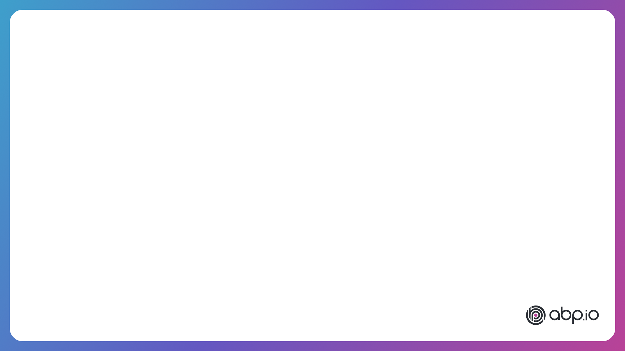
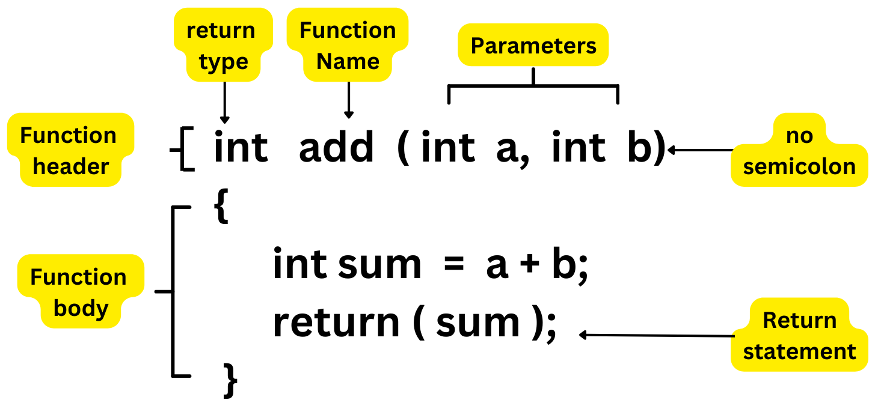
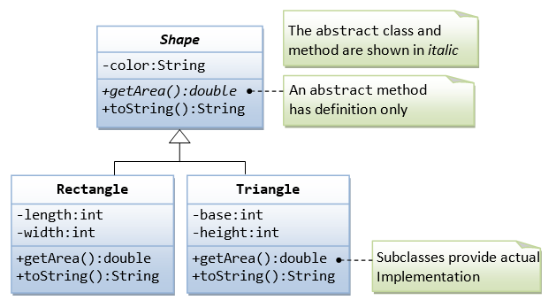

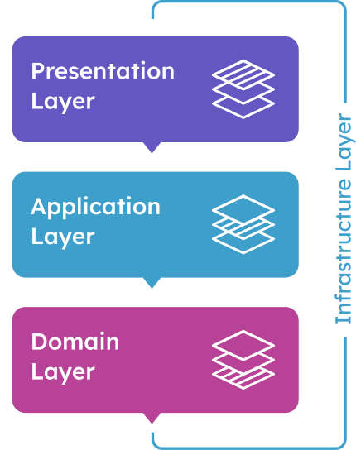
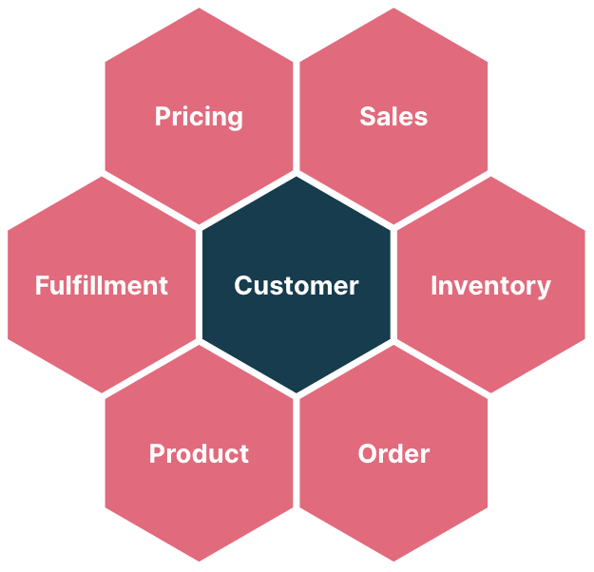
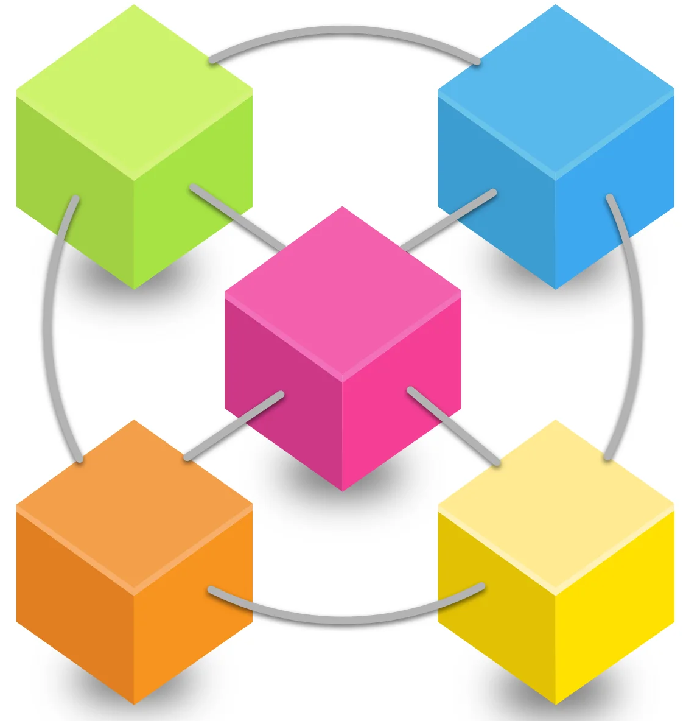
A DEVELOPER’S JOURNEY
HTML, CSS, JS
MVC, Razor Pages
Entity Framework
REST API
Databases
Authentication
Inheritance
Polymorphism
SOLID Principles
Design Patterns
int main() {
“Hello World”
}
multiple functions
object oriented programming
single-layer web application
n-layer architecture
modular monolith
microservices
Clean Architecture
Domain Driven Design
Bounded Contexts
Integration Patterns
Docker, Kubernetes
API Gateway
Communication Patterns
Distributed Transactions
DevOps

Slide 3
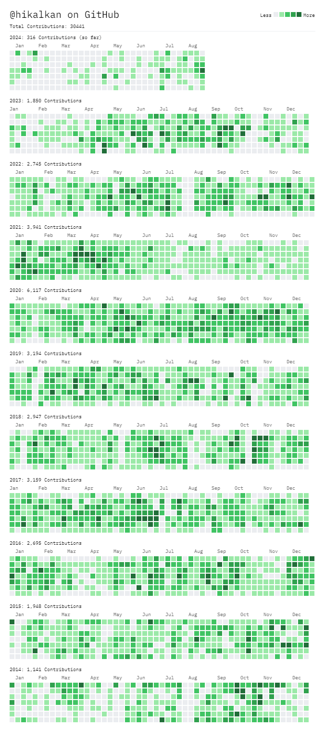







ABOUT ME: HALİL İBRAHİM KALKAN
1997, Started programming (at 14 years old, with Turbo Pascal)
2003-2007, Computer Engineering
2007 - 2015: Software developer, software architect, team leader
2016 - ∞: Co-founder, software architect
2013 - ∞: Lead developer of the open source ABP Framework
Multi-threading, distributed/microservice systems, OOP, DDD, software architectures.. etc.
Still active coder, open-source contributor
30,000+ total contributions on GitHub

Slide 4
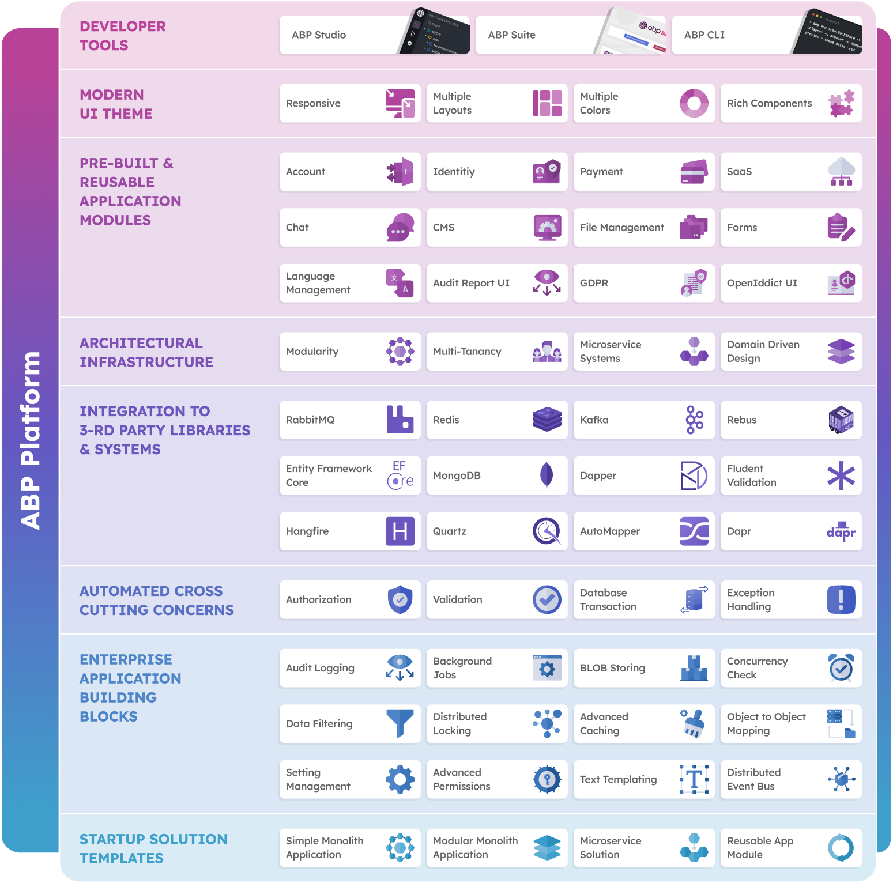
THE ABP PLATFORM
30 Reusable application modules
All modules;
Independent of any business
Independent from each other
Supports EF Core & MongoDB
Supports MVC, Blazor, Angular UI
Supports modular monolith & microservice scenarios
Extensible & customizable

Slide 5

AGENDA
Why modularity?
Architectural options - Database - Codebase - User Interface
Integration - Designing dependencies - Communication patterns
Which architecture?

Slide 6

WHY MODULARITY?
Reducing & managing code complexity
On-premise modular deployment
Migrating to microservices later

Slide 7

DESIGNING
MODULAR
ARCHITECTURE

Slide 8
MODULE TYPES
Business modules - Catalog - Ordering - Shipping - User reviews
Aggregator modules - Reporting / dashboard
Infrastructure modules - Setting management - Permission management - Background jobs - Email & SMS Sending
Generic modules - User & role management - Audit logging - GDPR - Chat

Slide 9
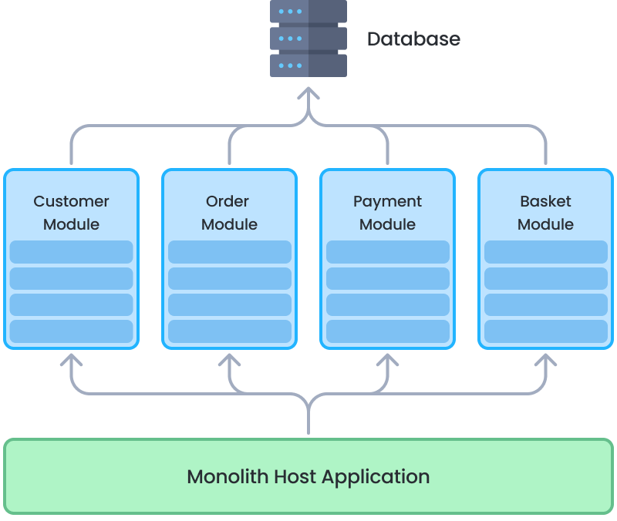
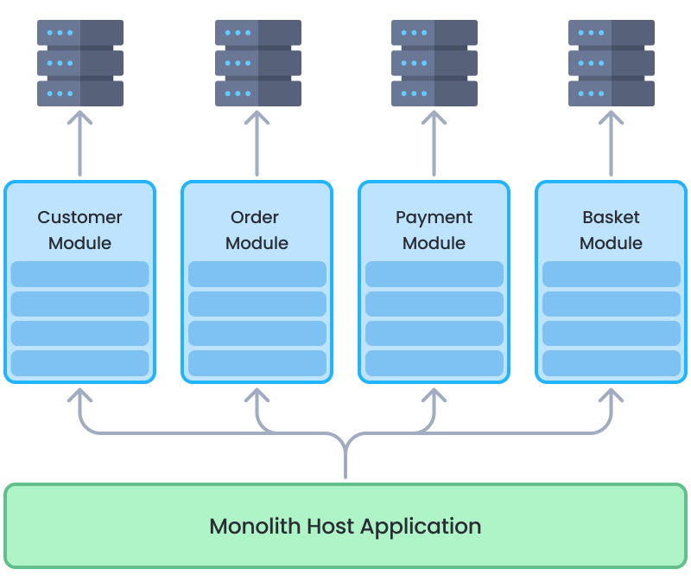
DATABASE ARCHITECTURE OPTIONS
Single (Shared) Database
Separate Module Databases

Slide 10
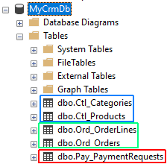
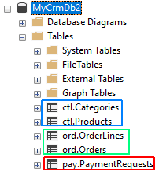
DATABASE ARCHITECTURE: SINGLE DATABASE
Separate by Table Prefix
Separate by Database Schema

Slide 11
DATABASE ARCHITECTURE: SINGLE DATABASE
Use separate connection strings for each module;
Server=localhost;Database=MyCrmDb2;User Id=catalog_module;Password=1q2w3E*;
Server=localhost;Database=MyCrmDb2;User Id=order_module;Password=abcABC*;
Data access approaches;
Access to only own schema / tables
Manipulate own schema & Read-only access to others

Slide 12
DATABASE ARCHITECTURE: SINGLE DATABASE
Pros:
Easier to build, maintain and backup the database
Possible to make multi-module table JOIN
Possible to ensure database level transactions
Cons:
Easier to break modularity
Schema changes of a module may require change on others (on read-only access)
All modules use the same DBMS technology
Scaling independently for a module is not possible

Slide 13
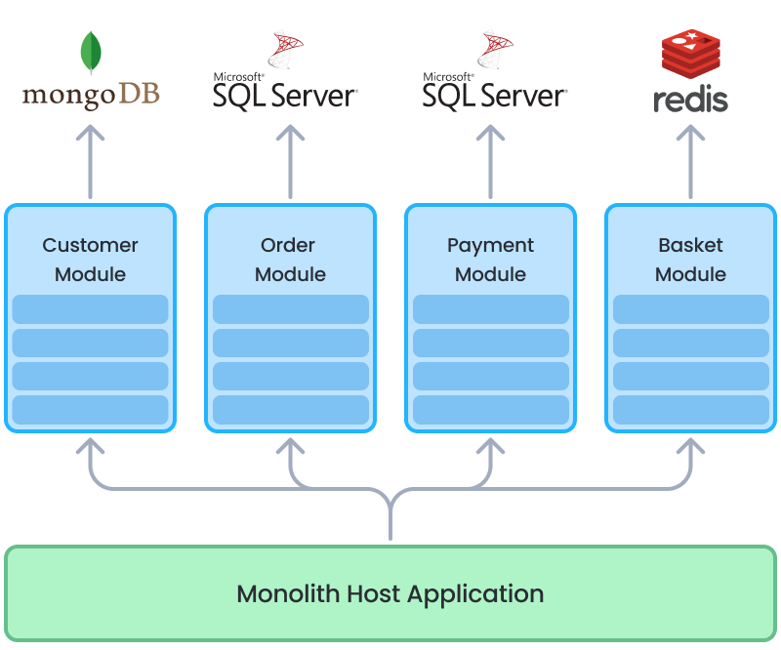
DATABASE ARCHITECTURE: SEPARATE DATABASES
Pros:
Best data isolation
Use Best DBMS technology for each module
Scale databases independently
More microservice ready
Cons:
Hard to prepare multi-module reports
Hard to ensure database level transactions
Hard to set up, maintain and backup
Hybrid: Separate databases only when needed!

Slide 14
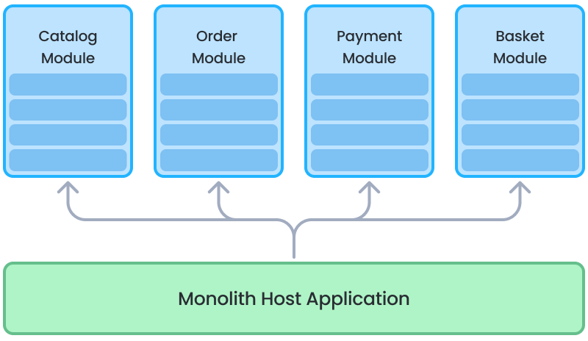
CODEBASE STRUCTURE
Single Solution
Multiple (Separate) Solutions

Slide 15
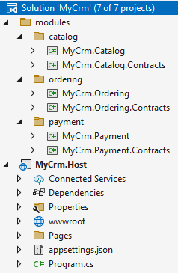
CODEBASE STRUCTURE: SINGLE SOLUTION
Easier and faster to develop and test
Easier to catch breaking changes
Good for small teams
Good if a developer working on multiple modules

Slide 16
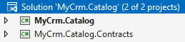
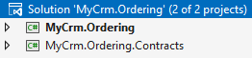
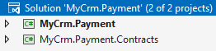
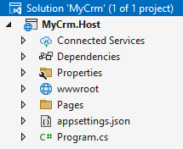
CODEBASE STRUCTURE: MULTIPLE SOLUTIONS

Slide 17
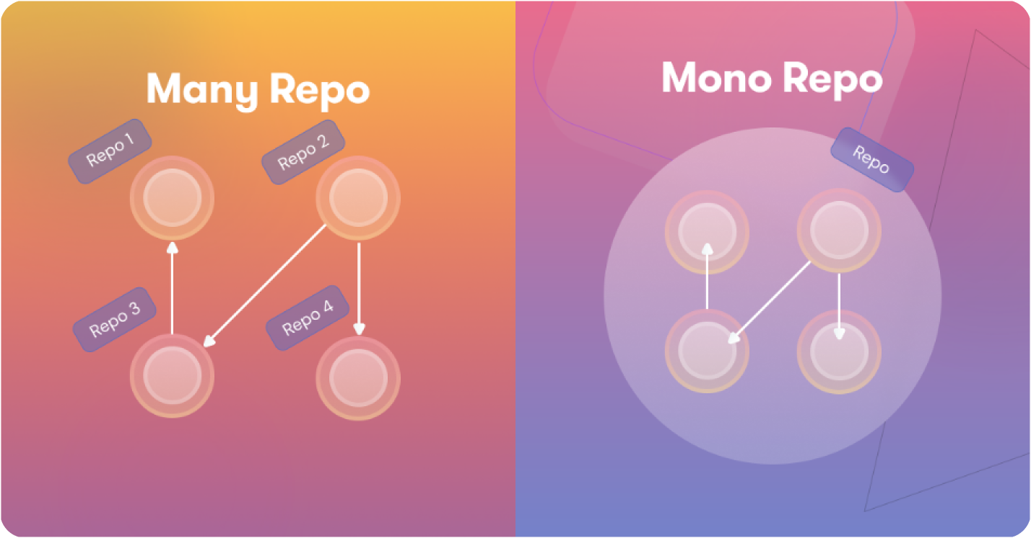
CODEBASE STRUCTURE
?

Slide 18
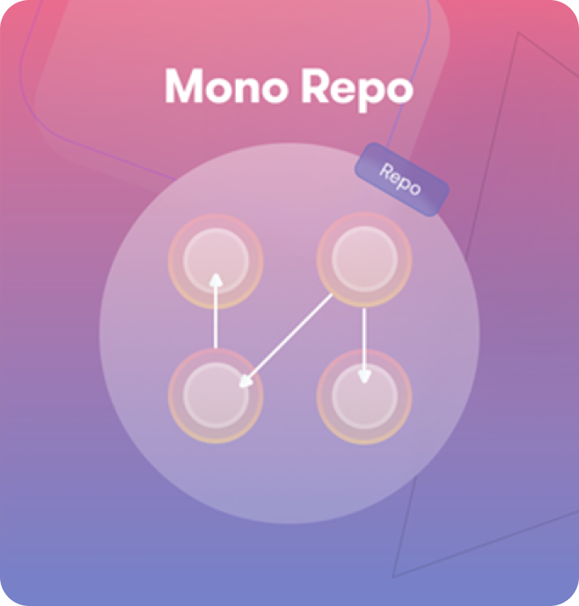
CODEBASE STRUCTURE: MONOREPO APPROACH
All modules are in a single Git repository
Uses local package references (dependencies)
All modules are in same version and deployed together
Pros:
Access to changes immediately by other modules - Good to use new features by other modules - Easier to detect and fix breaking changes
Easier develop, version, test and deploy cycle
Best when:
Small team - A developer work on multiple modules
Modules are small, frequently changing, well integrated
Suggested for majority of projects, especially in the early stages

Slide 19
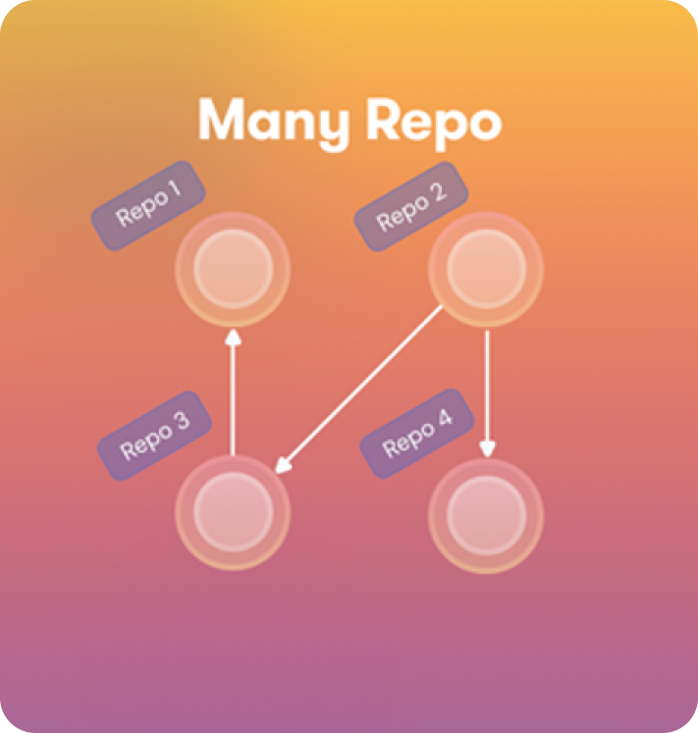
CODEBASE STRUCTURE: MANYREPO APPROACH
Every module located in a separate Git repositories
Uses package (NuGet, NPM, etc) references
Moduls are versioned and deployed separately
Pros:
Independent, more focused development for modules
Cons:
Wait changes on depended modules
Deal with breaking changes & backward compability
Complex to develop, test and deploy
Best when:
Many teams (or departments) specialized on different modules
Modules are mature and boundaries are stable or integration is limited
Considering to move to microservices soon

Slide 20
CODEBASE STRUCTURE: SUGGESTIONS
Always begin with - Monorepo - Single solution
Once the module count and team size increases - Monorepo - Multiple solutions
Preparing to a microservice migration - Multiple Repository - Multiple solutions

Slide 21
USER INTERFACE: ARCHITECTURE OPTIONS
Single (Unified) UI Layer
Modular UI
Component Based Modular UI
Hybrid Approach

Slide 22
UI LAYER: SINGLE / UNIFIED LAYER
Modules only define application services
The Host application contains all the UI pages and components
Pros:
Easy to create pages that uses multiple modules
Simple UI architecture
Cons:
Ignores modularity on UI level
Notes:
Still ready for microservice migration

Slide 23
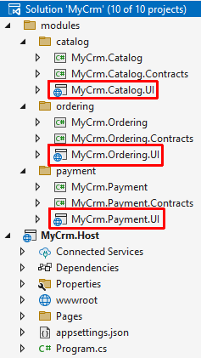
UI LAYER: MODULAR UI
Modules define their own UI pages and components
The Host application brings them together
Pros:
Independent, simple UI pages/components
Cons:
Hard to build pages that uses multiple modules
Complex UI architecture

Slide 24
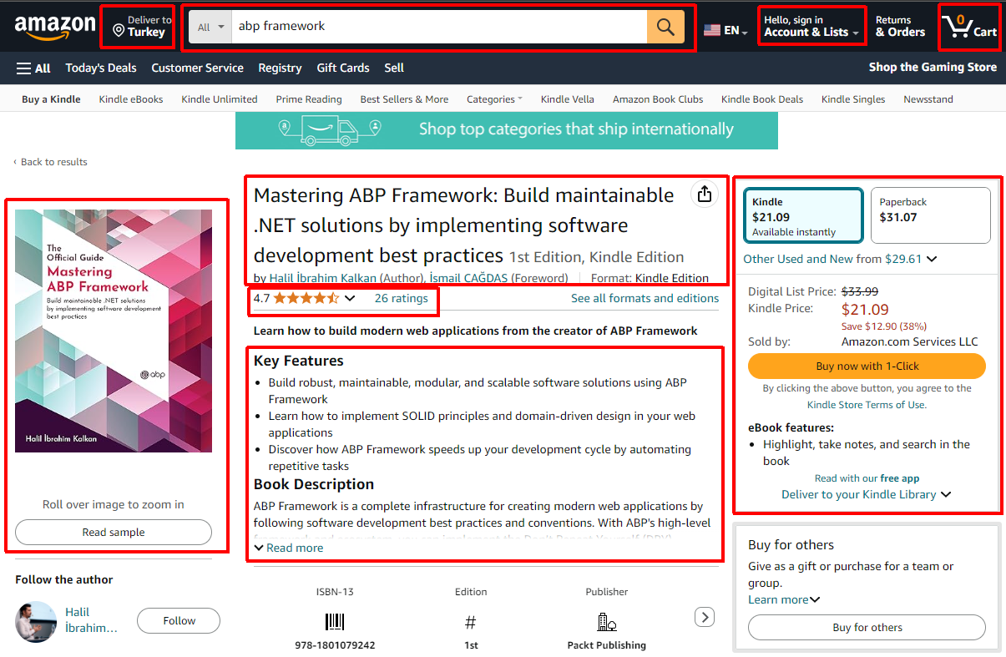
UI LAYER: COMPONENT BASED MODULAR UI
Catalog
Stock
Basket
User Ratings / Reviews
Shipping / Delivery
Related / Suggested Items
Search
User account
...

Slide 25
UI LAYER: HYBRID APPROACH
Independent modules can define their own pages - Example: User management, audit logging, ...
Host application contains pages that uses multiple modules - Example: Reports, dashboards
Modules define components and host application (or other modules) composes them

Slide 26
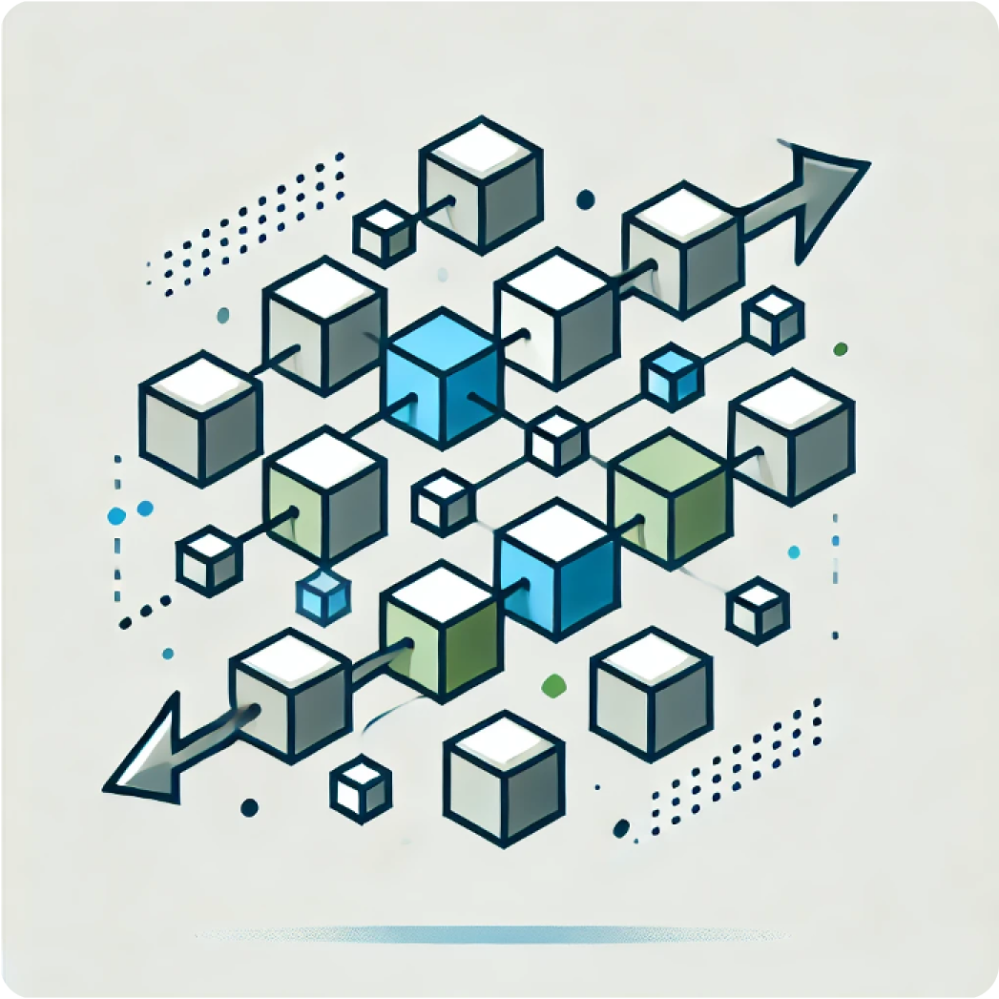
INTEGRATING THE MODULES

Slide 27
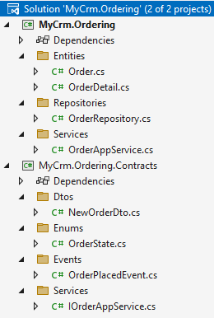
MODULE PACKAGE STRUCTURE
MyCrm.Ordering -> Implementation
Entities, Repositories, Services, etc..
MyCrm.Ordering.Contracts -> Interface
Service interface, DTOs
Event definitions
Enums, constants, etc..

Slide 28
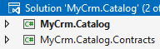
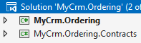
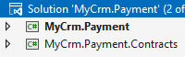
MODULE DEPENDENCIES (ON CONTRACTS)
Ordering Module -> IProductService.CheckStockCount(id)
Ordering Module -> IPaymentService.CreatePaymentRequest(…)
Catalog module -> Subscribe to OrderPlaced & OrderCanceled events

Slide 29
MODULE DEPENDENCIES (ON IMPLEMENTATION)
Pros: - Able to directly perform JOIN queries - Can manipulate data of the target module
Cons: - Leak of abstractions & modularity
Limitations: - Can not separate to microservices later - Can not separate databases later
Exception: - A module extends the other one (Ordering.Enterprise -> Ordering.Basic)

Slide 30
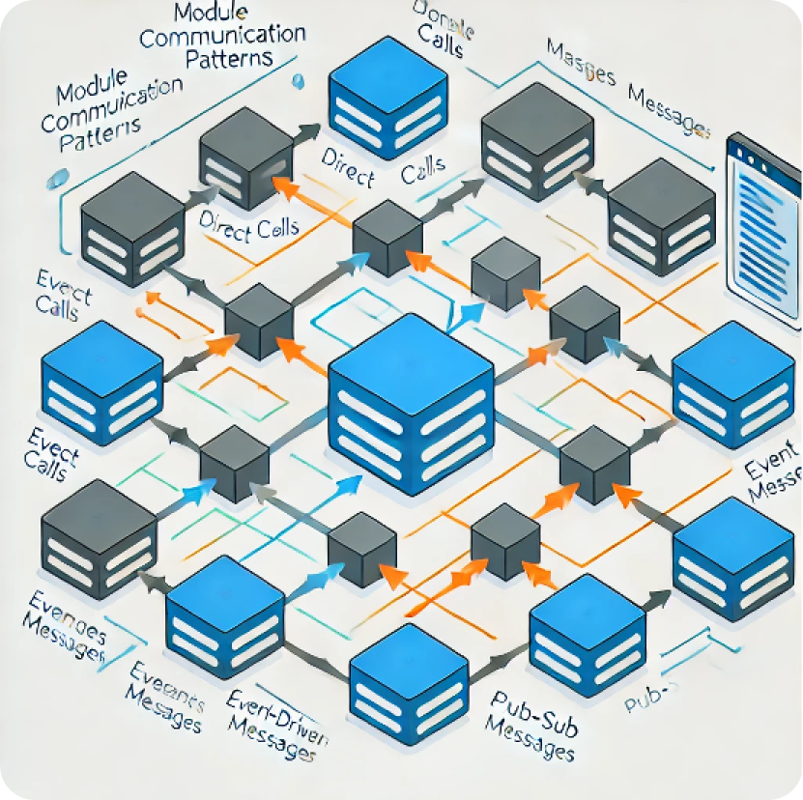
MODULE COMMUNICATION PATTERNS
Integration Services
Integration Events

Slide 31

INTEGRATION SERVICES
Best for read / query operations
Implement caching if possible
Do not reuse application services for integration purposes - Authorization - Caching - Localization - DTO properties - Single responsibility!
UI Application
place
order
monolith host (single process)
Ordering Module
query stock
Catalog Module
ordering database
catalog database

Slide 32
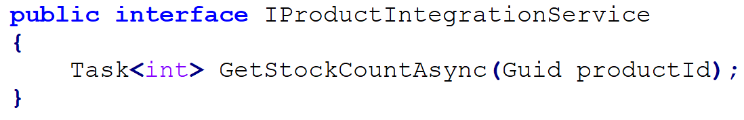
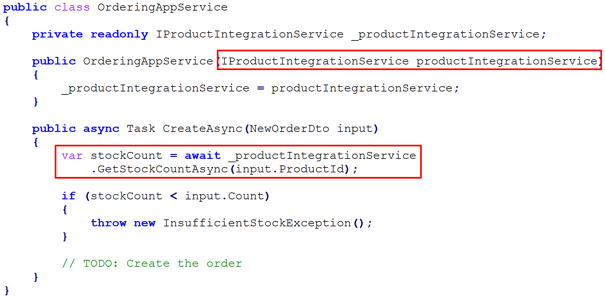
INTEGRATION SERVICES: EXAMPLE
Catalog Module (contract)
Ordering Module

Slide 33
INTGRATION EVENTS
Implement side effects (a change triggers another change in other modules)
One publisher multiple subscriber
UI Application
place
order
monolith host (single process)
event OrderPlaced
Ordering Module
Catalog Module
ordering database
catalog database

Slide 34
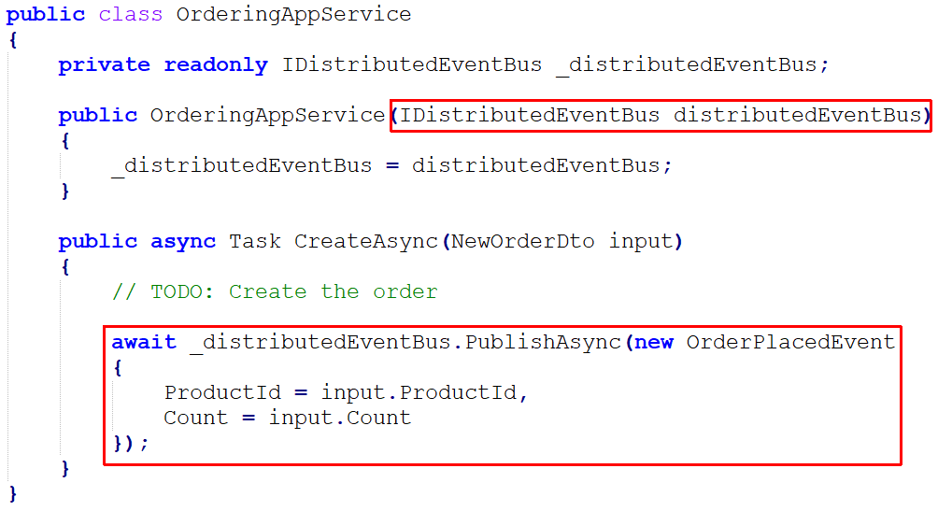
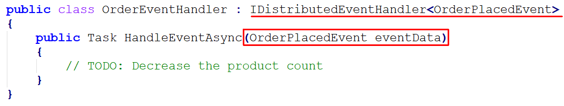
INTGRATION EVENTS: EXAMPLE
Ordering Module
Catalog Module

Slide 35
WHICH ARCHITECTURE..?
single-layer
n-layer architecture
modular monolith
microservices
Small project
Temporary project
A few developers
Middle-size project
Long-term project
A team of developers
Multiple applications
Complex domain
Multiple sub-domains
Multiple teams
Scaleable codebase
Scaleable performance (on multiple databases)
Complex domain
Multiple sub-domains
Multiple teams
Large company & budget
Devops culture
Scaleable codebase
Scaleable performance
Multiple technology stacks
Targeting too many users
- High availability
- Fault tolerance - Independent scale
%5-10
%50-60
%20-30
%5-10

Slide 36


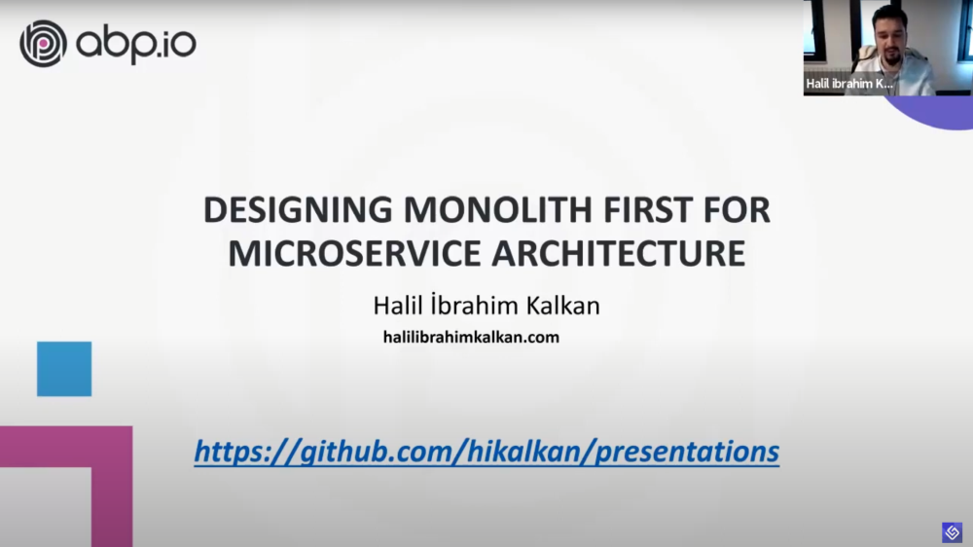
MIGRATING TO MICROSERVICES

Slide 37

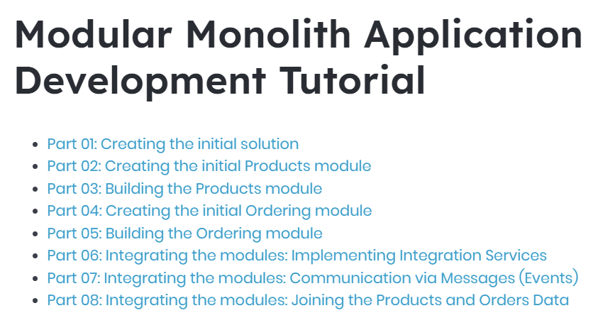
RESOURCES

Slide 38


Download This Presentation
THANKS FOR
LISTENING
Halil İbrahim KALKAN
Volosoft, Co-founder
@hibrahimkalkan
@hikalkan

Slide 39
TITLE
TODO

Slide 40
REMOVED PARTS...

Slide 41

REDUCING AND MANAGING CODE COMPLEXITY
When you have - A large system with multiple sub-domains - Multiple teams and developers
Easier to understand and develop manage individual modules - Easier to find & fix problems (!)
Develop, test and deploy independently

Slide 42
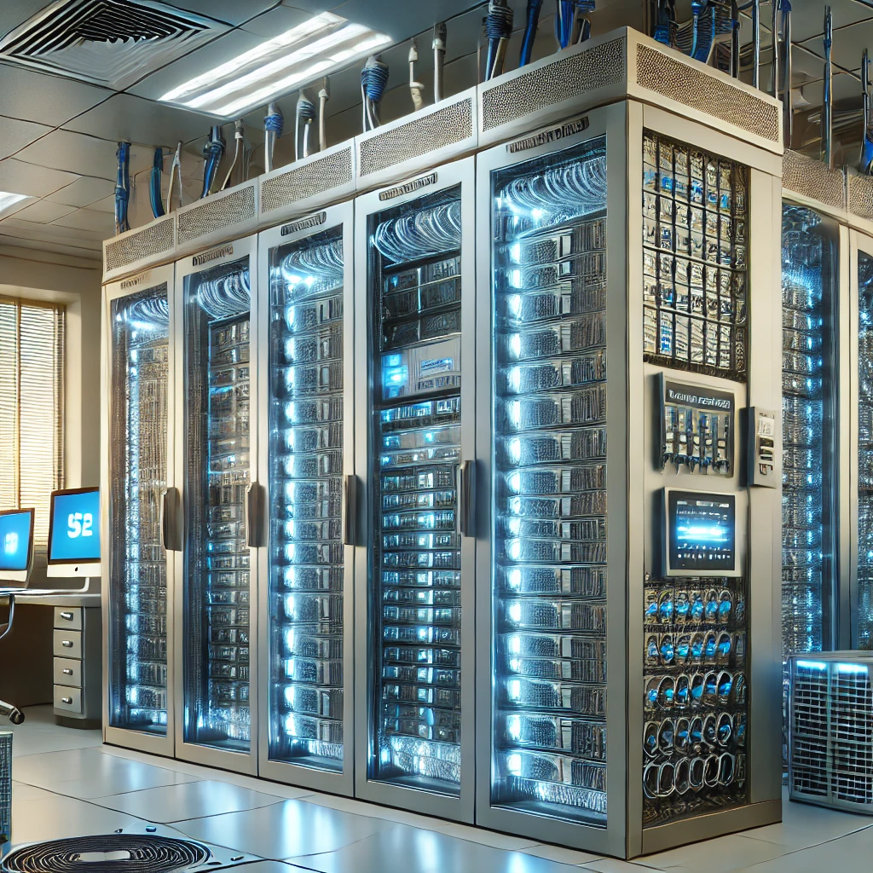
ON-PREMISE MODULAR DEPLOYMENT
Deliver only the modules they have purchased - Requires a completely loose coupled design - The system should work when you remove a module - Can load modules as plug-ins (on application launch time)
Alternative: Enable/disable features on runtime - Obfuscating DLLs

Slide 43

DATABASE-LEVEL TRANSACTIONS
Integration Services - Only for read, do not manipulate data - Manipulation: Can only work in monolith & single database approach
Events - Monolith & single database: Execute events in the same transaction - Distributed or different databases: Outbox/inbox pattern

Slide 44
FRAMEWORK REQUIREMENT..?
Base classes: Entity, repository, service, controller
Basic Infrastrucure: Event publishing & handling, transaction management, background job system, permission system, caching
Modular infrastructure
Generic modules: User management, audit logging, language management, etc.
Automating cross-cutting concerns: Validation, exception handling, etc.
3-rd party integrations & abstractions
...

Slide 45
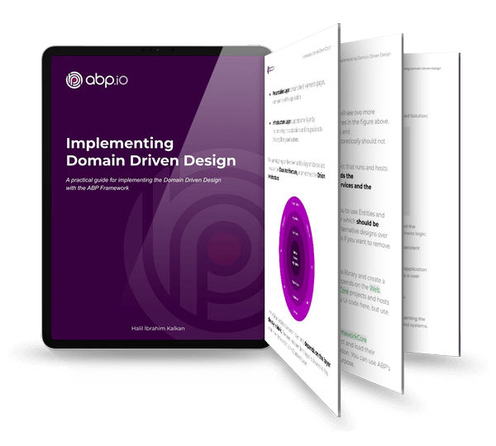

RESOURCES

